Slide 1
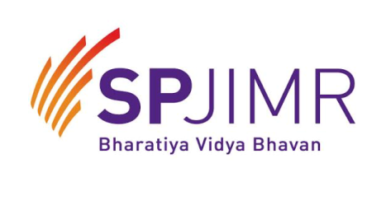
Centre for Project Management Welcomes you to Post Graduate in Advanced Project Management Blended Programme Batch 33 – PG-APM

Slide 2
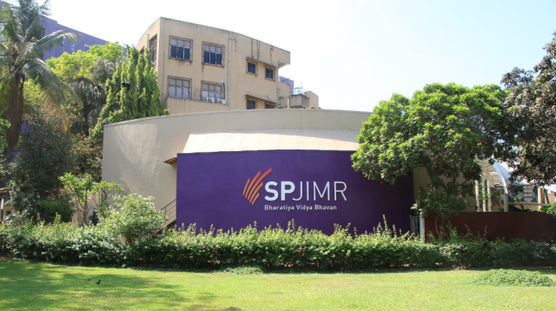
Welcome to SPJIMR

Slide 3
About SPJIMR
S P Jain Institute of Management and Research (SPJIMR) is a leading school of management in the heart of India’s financial centre, Mumbai. SPJIMR is a part of the Bharatiya Vidya Bhavan and functions as an autonomous institute with entrepreneurial agility. It consistently ranks amongst the top ten management institutes in India.
Inaugurated in 1981 by the then British Prime Minister, the Late Hon. Margaret Thatcher, SPJIMR’s mission is to Influence Practice and Promote Value-based Growth. It builds on this mission through pedagogic innovations and pioneering programmes, carving a distinctive path in management education.
SPJIMR has acquired the reputation of meeting societal needs of under-managed sectors by offering unique, purposeful and relevant initiatives. More than 1,000 participants from diverse backgrounds are enrolled at any given time across a range of management programmes offered by SPJIMR.
Accreditation – AACSB, AMBA, NBA & AICTE approved.
SPJIMR, is a Registered Education Provider (R.E.P) approved by Project Management Institute (PMI)® - USA.
Since the year 2000 SPJIMR has offered for various Project Management Courses.

Slide 4
Rules and Regulations
The details of programs scheduled have already been shared with you in the Welcome note.
You are expected to check the mails regularly for information and updates.
The timings for the sessions is already mentioned in the Roadmap document.
You are expected to be ready 15 minutes before the scheduled time. In case of any exceptional reasons, prior permission of the course coordinator is necessary.
80% Attendance is mandatory for online sessions.
The Course Faculty/Co-coordinator retain the right, not to allow candidates who are late.
In case of absence, advance intimation has to be given to the Course Faculty/Co-coordinator.

Slide 5
Evaluation of Performance
Certificates will be awarded in four grades, as per the percentage marks scored by the students as given below :
Less than 60% - Certificate of Participation
60% & less than 75% - Post Graduate in Advanced Project Management
75% & above – Post Graduate in Advanced Project Management (Honours)
Non Graduates (with min 15 years of exp) - Advanced Project Management
Assessment 1 | 40%
Assessment 2 | 40%
Assessment 3 | 20%

Slide 6
Faculty Profile

Slide 7

Dr. Vanita Bhoola ILPSE, INSEAD PhD, Risk Management PMP®, Prince 2 | Dr. Vanita Bhoola serves as a Professor at SP Jain Institute of Management & Research, Mumbai. She has 22 years of experience in Training and Consulting in Project Management and Decision Support Systems. Apart from teaching and publishing in top tier international journals, her expertise involves offering customizing programs for corporate based on prior research about company, sector and the immediate business environment that impacts business. This involves weaving the specific needs of individuals / departments/organizations at diversified levels. Dr. Bhoola has handled projects and consultancy assignments with corporate clients, such as, Pfizer, Kalpataru Group, CGI, GAIL India, Abbott Health Care, Mazgaon Dock, Siemens, ICICI Securities, Deutsche Bank, Procter & Gamble, Colgate-Palmolive, Tata Housing, Brigade Group, KEC International, Quality Kiosks, Mahindra & Mahindra, Verchuska Infotech and Godrej Infotech.

Slide 8
Mr. M. Hariharan FCA, AICWAI | Mr. Hariharan has advised corporates across industry sectors, like Steel, Cement, Automobile, Auto ancillary, Bank, Insurance, Power, Infrastructure Construction, etc. He has done pioneering work in the field of Strategic Cost Management. He is presently working on a book on “Sustaining Inequality of Value, Price and Cost – Journey of Cost Excellence”. He has conducted more than 600 training programs and trained a number of managers on the concept of Lean, Constraints Management and Cost Management. He has been rated as the Best Professor of the Year 2009, by SP Jain Center of Management, Dubai and Singapore. He has presented papers in various international forums. He regularly writes for Business Magazines. Mr. Hariharan, is a member of CII-Total Cost Management movement. The movement is spreading the concept of TCM and developing a Maturity Model for TCM. He is also a member of the Manufacturing Excellence Sub Committee of the CII. Mr. Hariharan is a Charter Member of TiE (The Indus Entrepreneurs). He is on the Board of Trustees of TiE Mumbai Chapter (2010-12). As a charter member he mentors entrepreneurs in their initiatives. He also does mentoring of wannabe entrepreneurs with business ideas through the business plan initiative of ECell- the IIT Bombay Mentorship program.

Slide 9
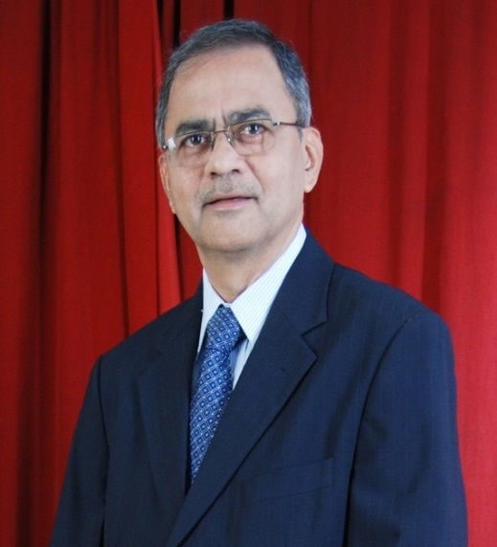
Dr. Anil Vaidya Doctor of BA (University of Bradford, UK), MBA (University of Akron, USA) B.Sc. (Tech), LLB ISACA, CISA, CISM, ITSM | Dr. Anil Vaidya is Professor of Information Management, also holds responsibility as Area Head of ‘Information Management’ at SPJIMR. Prior to joining SPJIMR he was industry practitioner for 35 years, in CIO roles in MNCs such as Philips, Rhone-Poulenc and Parke-Davis. In Philips he progressed from Country role, as Sr. Director IT, to Cluster Director role to AsiaPacific role to Global role; was based in Eindhoven, Netherlands, in Philips IT HQ for 3 years. Study of technological advances and their impact on business and society has been one of the passions of Dr. Anil Vaidya. In this role as Professor he teaches management students technologies such as IOT, AI, ML, Blockchain, Big Data and brings to the fore value creation thru deployment of these.

Slide 10
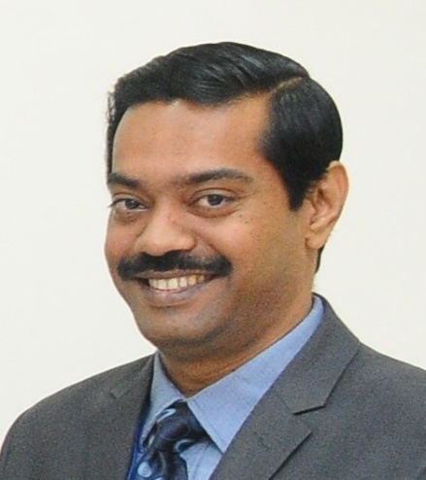
Dr. Ravindra Dey MHRDM (Mumbai University), MDSE, M.Com | Prof. Dey Specializes in Organizational Behavior, Organization Development, Human Resource Development and Competency Assessment. Professor, Head of Organizational Behavior at Xavier Institute of Management & Research (XIMR), Mumbai. Currently pursuing Fellow Program in Management from Academy of HRD, Ahmedabad. Actively engaged with consulting and training work in the corporate, education and social development sectors. Handled programmes on a wide range of topics in the field of behavioural sciences, HRD, Organisation Development and management for within the organisation and a few assignments for Management Institute and other organisations. Some of the training / consulting assignment handled are Organizational Effectiveness, Performance Development, Strategy and Vision, Customer Service Excellence, Customer Relations Orientation, Conflict Resolution, Negotiation Skills, Personality Development, Communication and Interpersonal Relationship Workshop, Development and Assessment Centre. Has about 20 years of experience spanning the corporate sector as well as the academic sector. In the corporate sector, worked as Vice President (HR & Admin), EWDL, Indore, General Manager – HR, TCGRE, Mumbai, DGM-HR at Wockhard and Head of HR for OMCI, Mumbai. Published research papers in reputed Journals Author of 2 books on Perspective Management and Organizational Theories Structures and Design.

Slide 11
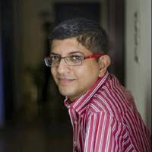
Mr. Chaitanya Sabne | 17 years of experience in the industry and has experience in Project Management, Program Management, Consulting and Training. He has been a hands-on Project Management practitioner and has successfully managed large and complex programs. Training Areas PMP PRINCE2 ITIL IT Security Auditor Lead Auditor Six Sigma Training Highlights Has managed various software development and AMS projects successfully Delivered Guest Lectures for Educational Institutes Experience with designing Training Contents Ability to comprehend Training Requirements & deliver training accordingly

Slide 12
Ice – Breaking activity

Slide 13
Introduction
Your Name
What makes you so unique
How and what would you contribute to the class learning?
Rate your self in the scale of 1 – 10 (10 being highest) in Project Management

Slide 14
Different Certification of PM
Project Management Institute®, USA (PMI)
IPMA ® (International Project Management Association)
Association of Project Management (APM)

Slide 15
London Heathrow Terminal T5 Case
California Review Management
Andrew Davies, David Gann, Tony Douglas

Slide 16

Video

Slide 17
The Bad News: Most Projects Still Fail
Why do well managed projects fail?
Failure is often found even in well –managed projects, run by experienced managers
Appreciate up front the extent of uncertainty and complexity involved
Failing to adapt management style to the situation
Why Traditional Project Management Often Fails?
“management-as-planned” philosophy
Triple-constratint (iron-triangle)
One-size-fits all

Slide 18
Start Smart
For example, a NASA study of software development projects concerning the relative cost of repair showed that it costs 10 times more to fi x a defect during the coding phase than during the design phase and 100 times more to fi x a defect during the testing phase than during the design phase.
Remer’s Rule of 10 states that it costs approximately 10 times more to fi x the problem at each later stage of the project. For example, if it costs $ 10,000 to fi x a problem during the planning stage, it will cost $ 100,000 to fi x it at the design stage, and $ 1,000,000 to fi x it during the construction stage. Several published studies have confirmed that Remer ’ s Rule applies to all kinds of projects.
Isn ’ t it ironic that those people who claim they don ’ t have enough time to plan always have enough the time to start over when their shoddy initial planning drives their project over a cliff?
The lesson is clear: Invest sufficient planning time and effort early because the cost savings are huge
A review of most failed project problems indicates that the disasters were well - planned to happen from the start. The seeds of problems are laid down early. Initial planning is the most vital part of a project. — NASA Rule #15

Slide 19
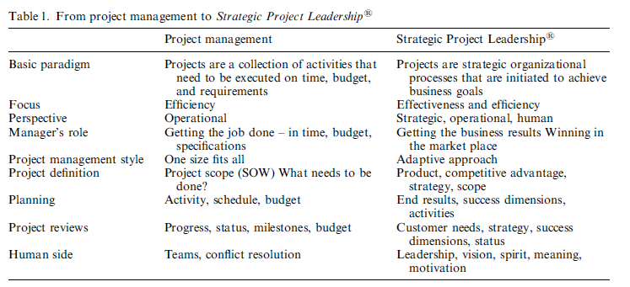
Shenhar, A. J. (2004). Strategic Project Leadership® Toward a strategic approach to project management. R&d Management, 34(5), 569-578.

Slide 20
Towards an Adaptive Project Management Approach
An approach that builds on the traditional approach
“What you measure is what you get”
New success criteria : five dimensions or metrics
Project efficiency : meeting time and budget goals
Impact on the customer : meeting requirements and achieving customer satisfaction, benefits and loyalty
Impact on team : satisfaction, retention, and personal growth
Business results : return on investment, market share and growth
Preparation for future : new technologies, new markets, and new capabilities

Slide 21
Reinventing Project Management – By Aron J. Shenhar One size does not fit all
Each type will have a Unique Impact on Project Management
Novelty – ranging from ‘derivative’ to ‘new-to-the-world’
Technology – ranging from ‘low-tech’ to ‘super-high-tech’
Complexity – ranging from ‘component level’ to ‘system of systems’
Pace – ranging from ‘ regular’ to ‘blitz’
Technology
Complexity
Novelty
NTCP
Pace

Slide 22
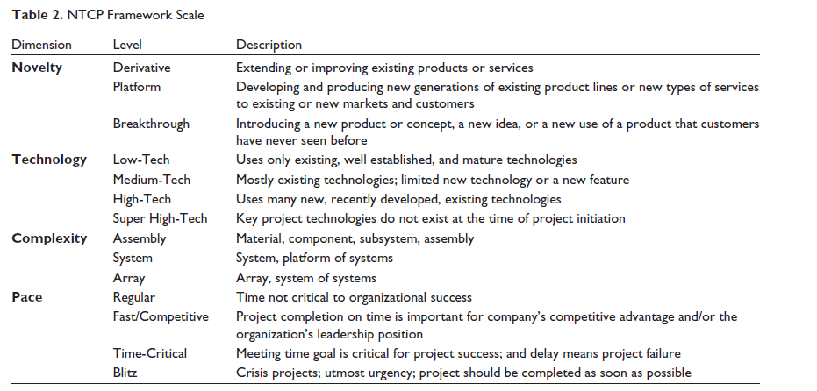
Source : Pati, R. K., Kumar, V., & Jain, N. (2015). Analysis of Aadhaar: A project management perspective. IIM Kozhikode Society & Management Review, 4(2), 124-135

Slide 23
Technology
Super - High-Tech
High-Tech
Medium-Tech
Low-Tech
Array
System
Assembly
Component
Complexity
Novelty
Derivative
Platform
New to Market
New to World
Regular
Fast/Competitive
Time - Critical
Blitz
Pace
Notes:
The NTCP model is a structured framework developed by Aaron J. Shenhar and Dov Dvir to enable project mangers to use for making decisions in terms of selecting the right projects, the right people, allocating resources, planning & risk assessment building processes and choosing the right tools. It helps decide on how projects should be run. Each dimension includes four levels.
Product Novelty has 4 levels. Derivative products are extensions and improvements of existing products (e.g., HUL adding a Jasmine soap in its portfolio). Platform products new generations of existing product lines (e.g., a new car model). Breakthrough products – something that customers have never seen before (e.g., 3M Post-it notes or the first 3D television). It can be of two types – new to market in which the project operates or new to the world. Next comes role of technology in the innovation. Low-tech projects rely on existing and well-established technologies – these are mostly the construction projects. Medium-tech projects use existing or base technologies, but incorporate a new technology in the form of incremental innovation. Typical examples would be appliances, automobiles, etc. High-tech projects use mostly new technologies (like defense development projects). Super-high-tech projects are based on new technologies that do not exist at project initiation (like the Mars landing program). Complexity of the project has the initial level of component – which implies a collection of basic components combined to a single unit or entity that form a single function of the project (such as an electronic toy). Assembly projects is a collection of elements and components and modules combined to a single unit – like a coffee machine. System projects involve a complex collection of interactive elements and systems, jointly performing multiple functions – such as cars, computers, buildings, etc. And lastly, Array projects deal with a large and widely dispersed collection of systems that function together top achieve a common purpose – like MTNL, or national power distribution system, etc. Last, but, not the least, is Pace. Regular implies where time is not crucial to immediate organizational success. Fast/Competitive are the most common projects carried out by industrial and profit-driven organizations, sometimes to form new business lines. Time-critical projects are like the Y2K project, which must be completed within a definite date or within a given event window. Blitz projects are the most urgent ones and most time critical – like evacuation of human being from a building caught by fire or earthquake.

Slide 24

Technology
Super - High-Tech
High-Tech
Medium-Tech
Low-Tech
Array
System
Assembly
Component
Complexity
Novelty
Derivative
Platform
New to Market
New to World
Regular
Fast/Competitive
Time - Critical
Blitz
Pace
Notes:
How would the NTCP model for Narayana Health look like? There is no path-breaking technological innovation involved, there was no specific deadline for completion, yet the complexity involved is extremely high and the novelty of the product is path-breaking. It stands as world’s 36th most innovative companies in a survey conducted in 2012. With 12,500 employees, 31 branches in 19 locations, largest telemedicine network in the world, and treating over 80,000 outpateints everyday, NH truly stands apart from the rest.
As far as novelty is concerned, making medical facilities affordable to the masses at a rate, which still ensure sustainability of the business, is a breakthrough project which is completely new to the world. It is also not a product that replaces previous versions in a well-established market. As far as technology is concerned, while NH relies mostly on existing and well-established technologies, though new features are added to build a completely new platform. Hence, it can be considered as medium-tech. It brings all these functions under the same platform, by creating a “systems of systems” or a “super-system”, keeping the quality and the standards the same across all the different locations. Hence, the project can be considered as highly complex – perhaps, an array project. The NH project was not time critical, but also cannot be called a regular project, as it served the need of the hour for thousands and thousands of poor persons, who could not afford heart surgeries. Hence, it would fall into the category of fast/competitive.

Slide 25

Technology
Super - High-Tech
High-Tech
Medium-Tech
Low-Tech
Array
System
Assembly
Component
Complexity
Novelty
Derivative
Platform
New to Market
New to World
Regular
Fast/Competitive
Time - Critical
Blitz
Pace
Notes:
Let us try to use the NTCP model for a few examples – let us consider the Delhi Metro – DMRC. As far as novelty is concerned, it is neither an extension or improvement of any existing project/product, nor a breakthrough project which is completely new to the world. It is also not a product that replaces previous versions in a well-established market. Hence, it can be considered as a “New to Market” project, which implies a new idea of a product that the existing market has never seen before. As far as technology is concerned, it can be considered as a medium-tech as it mainly uses existing technology thereby adding new features that did not exist in previous such projects, across India. In the context of complexity, perhaps, DMRC would score high, as it deals with a large and widely dispersed collection of systems and sub-systems, jointly performing multiple functions to meet a specific operational need. It brings all these functions under the same platform, by creating a “system of systems”. Hence, it can be a System project. As compared to DMRC, Kolkata Metro can be considered as a much simpler version and less complex, though it was conceived in 1984, approximately 3 decades prior to DMRC and was India’s first completely underground railway network. The DMRC project was not time critical, but cannot be called a regular project, as well. Hence, it would fall into the category of fast/competitive.

Slide 26

Technology
Super - High-Tech
High-Tech
Medium-Tech
Low-Tech
Array
System
Assembly
Component
Complexity
Novelty
Derivative
Platform
New to Market
New to World
Regular
Fast/Competitive
Time - Critical
Blitz
Pace
Notes:
Let us now try to use the NTCP model for Google Glass. As far as novelty is concerned, it is a breakthrough product and new-to-the-world. It transforms a new concept that customers had never seen or even believed before using it. As far as technology is concerned, it is based on assembly of technologies which have never before brought together for any project initiation. Hence, it is a high-tech project. As far as complexity is concerned, it can still be called a system project, as it deals with a large and widely dispersed collection of systems and sub-systems, jointly performing multiple functions to meet a specific operational need. While it cannot be called time-critical, but it is true that in the world of technological innovations, inventions get stale very fast. Hence, it can still be considered as a fast/competitive project. With the advent of Meta Pro, GlassUp, or Vuzix Smart Glasses or Optinvent, competition for Google Glass is at its peak. Hence, continuous innovation which could be sometimes incremental can prove success for Google.

Slide 27

Technology
Super - High-Tech
High-Tech
Medium-Tech
Low-Tech
Array
System
Assembly
Component
Complexity
Novelty
Derivative
Platform
New to Market
New to World
Regular
Fast/Competitive
Time - Critical
Blitz
Pace
Notes:
How would the NTCP diamond framework look for Netflix, which is a completely new technology that has revolutionized the world of entertainment. In terms of novelty, it is a breakthrough and a new-to-the-world product. The technology can be termed as super-high, as it did not exist at the point in time of project initiation – as it never existed earlier. Although the mission was clear, the solution was not. In terms of complexity, it can be a system project that involve a complex collection of interactive elements and subsystems. And in terms of pace – it can be considered as “regular” as there was no time-critical requirement.

Slide 28
Technology
Netflix
Google Glass
DMRC
Narayana Health
Super - High-Tech
High-Tech
Medium-Tech
Low-Tech
Array
System
Assembly
Component
Complexity
Novelty
Derivative
Platform
New to Market
New to World
Regular
Fast/Competitive
Time - Critical
Blitz
Pace
Notes:
This provides a comparative analysis of the pattern of four innovative projects in terms of the Diamond Framework. As you will observe, each has its uniqueness. Any project low on innovation has a threat of being replicated, if the system is not complex enough. DMRC is an exception, as it is a government-owned project and also the level of capital investment is high. Netflix is high on technology and novelty, but low on complexity – hence, threat is still low. Google glass, among all of these, is the most vulnerable innovation. Though it was an extremely novel innovation, the chances of imitation are high. This would keep Google Glass on its toes to incorporate incremental innovations, to remain in the race.

Slide 29
Aadhar – Diamond Framework
Pati, Rupesh & Kumar, Vipin & Jain, Nishtha. (2015). Analysis of Aadhaar: A Project Management Perspective. IIM Kozhikode Society & Management Review. 4. 124-135. 10.1177/2277975215610687.

Slide 30
Practice Assignment

Slide 31
London Heathrow Terminal T5
Break down the Program in sub-projects
Consider each project and the activities in terms of the NTCP framework.
https://sfuheathrowcase.wordpress.com/
For project related queries, please drop an email to the Prof. @ vanita@spjimr.org

